Slide 1
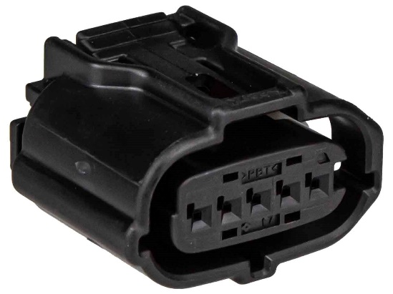
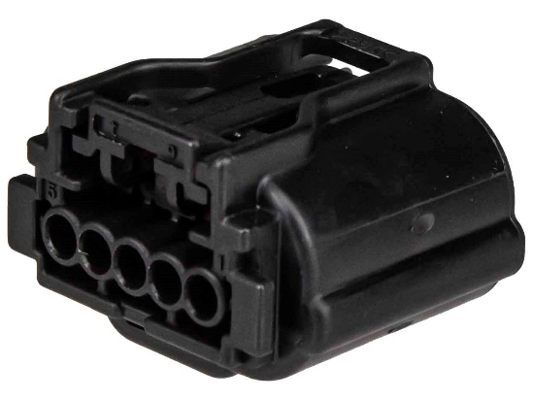
L: 22 mm W: 26.4 mm H: 17 mm
CH3434
SPECIFICATIONS
Shape: | Rectangular
Cavities: | 5
Gender: | Female
Max. Operating Temperature: | +120 °C
Min. Operating Temperature: | -40 °C

