Slide 1
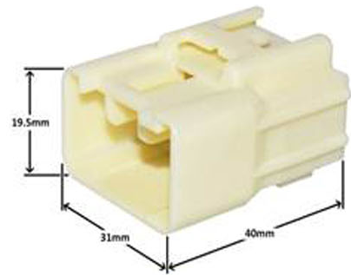
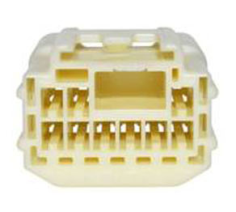
CH1571
SPECIFICATION
Shape: | Rectangular
Wire Gauge: | 22-14
Contact Resistance: | 3mΩ Max. (Initial)
 | 10mΩ Max.(After Durability Tests)
Leak Current: | 3mA Max
Insulation Resistance: | 100MΩ Min

Slide 2
ADDITIONAL SPECIFICATION
Operating Temperature (Max) (°C): | 70, 75, 80, 85, 90, 100, 105, 110, 120, 125
Operating Temperature (Max) (°F): | 158, 167, 176, 185, 194, 212, 221, 230, 248, 257
Operating Temperature Range: | -55 – 125 °C [ -67 – 257 °F ]
UL Flammability Rating: | UL 94V-1

