Slide 1
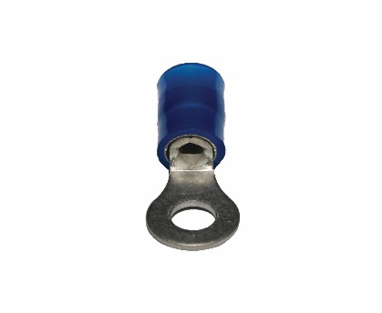
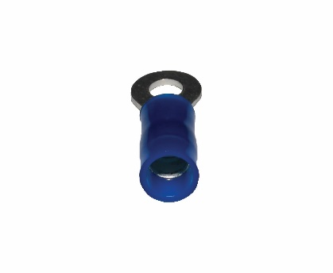
TE1920
SPECIFICATIONS
Type: | Ring
Termination Style: | Crimp
Barrel Type: | Insulation Grip Sleeve
Gauge: | 14 - 18 AWG
Voltage Rating: | 600 V
Insulation: | Nylon

